Slide 1
Utilizing Youth Participatory Action Research Approaches to Build Project CRATERS (Creating Responsive Action Through Empowering Resources and Strategies): Making an Impact
Ebonee Johnson, Ph.D.
Peyton Connolly
Isabella Rodriguez
Elizabeth Barnett
Srinidhi Kompella
Jason Dong
Emma Lamp
Claudia Lagunas
Jaedon Swanson

Slide 2
2022-2024
Acknowledgement: Youth Co-Creators
High School Students (Current college students-freshman)
  Amerie Alvarado
  Cooper Davenport
  Andrew Dong
  Alexandria Peterson
UI Graduate Students
  Jaron Jones
    (expected graduation 2025)
  Jessica Monday
    (expected graduation 2026)
  Ngonyo Mungara
    (expected graduation 2025)
  Emily Laverty, MPH

Slide 3
Acknowledgement: Youth Co-Creators
2023-2024
2022-2023
UI Graduate Students
  Jaron Jones
  Jessica Monday
  Ngonyo Mungara
  Shawn Sanyal
UI Undergraduate Student
  Cecile Bendera
UI Graduate Students
  Shawn Sanyal (expected graduation 2025)
  Alyssa Provencio
UI Undergraduate Student
  Nya Bottley (graduated c/o 2024)
  Mazvita Makoni
  Aracelli Hernandez

Slide 4
Agenda
Define community-engaged research and youth participatory action-research
Describe the process of module development
Provide an overview of the 4 modules of CRATERS
Describe next steps
  Recruitment and intervention delivery summer 2025
Provide examples of additional mental health outreach and engagement efforts
Group Activity and Q&A

Slide 5
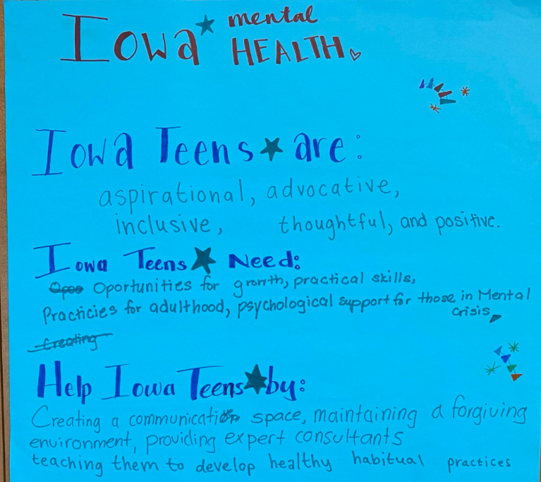
Community Engaged Research
An approach to research designed to improve health through the involvement of the impacted community in research
Involves community members and representatives from community organizations collaborating and sharing research roles with academic researchers.
Emphasizes collaboration and co-learning; reciprocal transfer of expertise; sharing of decision-making power; and shared ownership of the processes and products of research

Slide 6


Orienting Self to YPAR:
Dr. Emily J. Ozer
Ozer, E. J., Ritterman, M. L., & Wanis, M. G. (2010). Participatory action research (PAR) in middle school: Opportunities, constraints, and key processes. American Journal of Community Psychology, 46, 152-166.

Slide 7
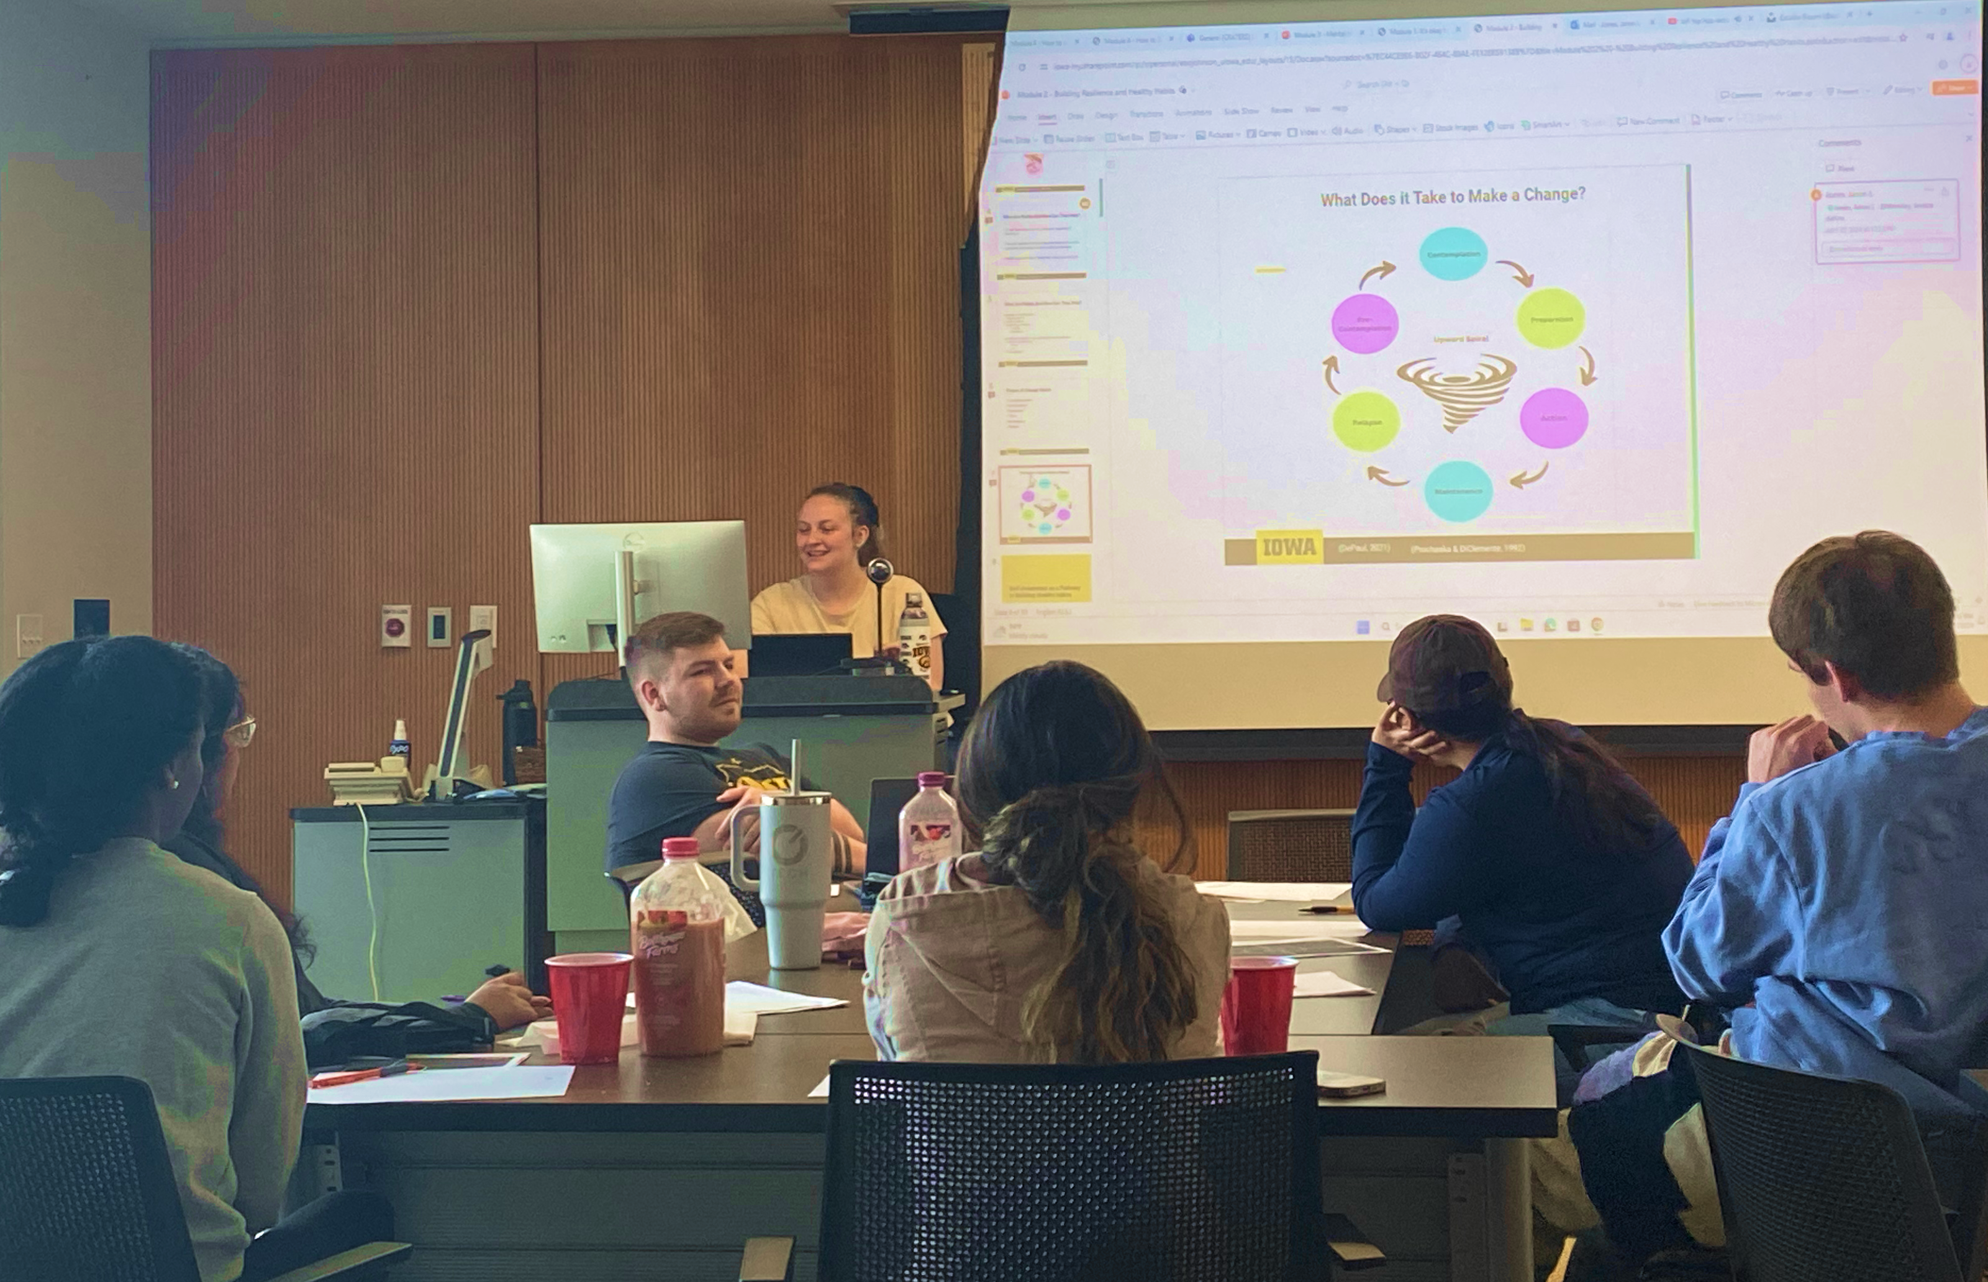
Youth Participatory Action Research
"Youth-led participatory action research (YPAR) is an approach to scientific inquiry and social change grounded in principles of equity that engages young people in identifying problems relevant to their own lives, conducting research to understand the problems, and advocating for changes based on research evidence" .

Slide 8
What is YPAR?
Collaborative
Grounded
YPAR is a collaboration between researchers and youth participants with each partner providing valuable input and feedback on all aspects of a project
YPAR is inquiry based. It is grounded in the lived experiences of youth, centering their perspectives throughout the project
Inclusive
Transformative
YPAR includes participants from groups who have been the most systematically marginalized or excluded
The purpose of YPAR is to actively change spaces and improve the lives of youth and their communities
Contextualized
YPAR is culturally relevant, placing the research within the context of where & how people are living
'I'm really excited! Thank you for this opportunity...it really means a lot to be able to...make these changes.’

Slide 9
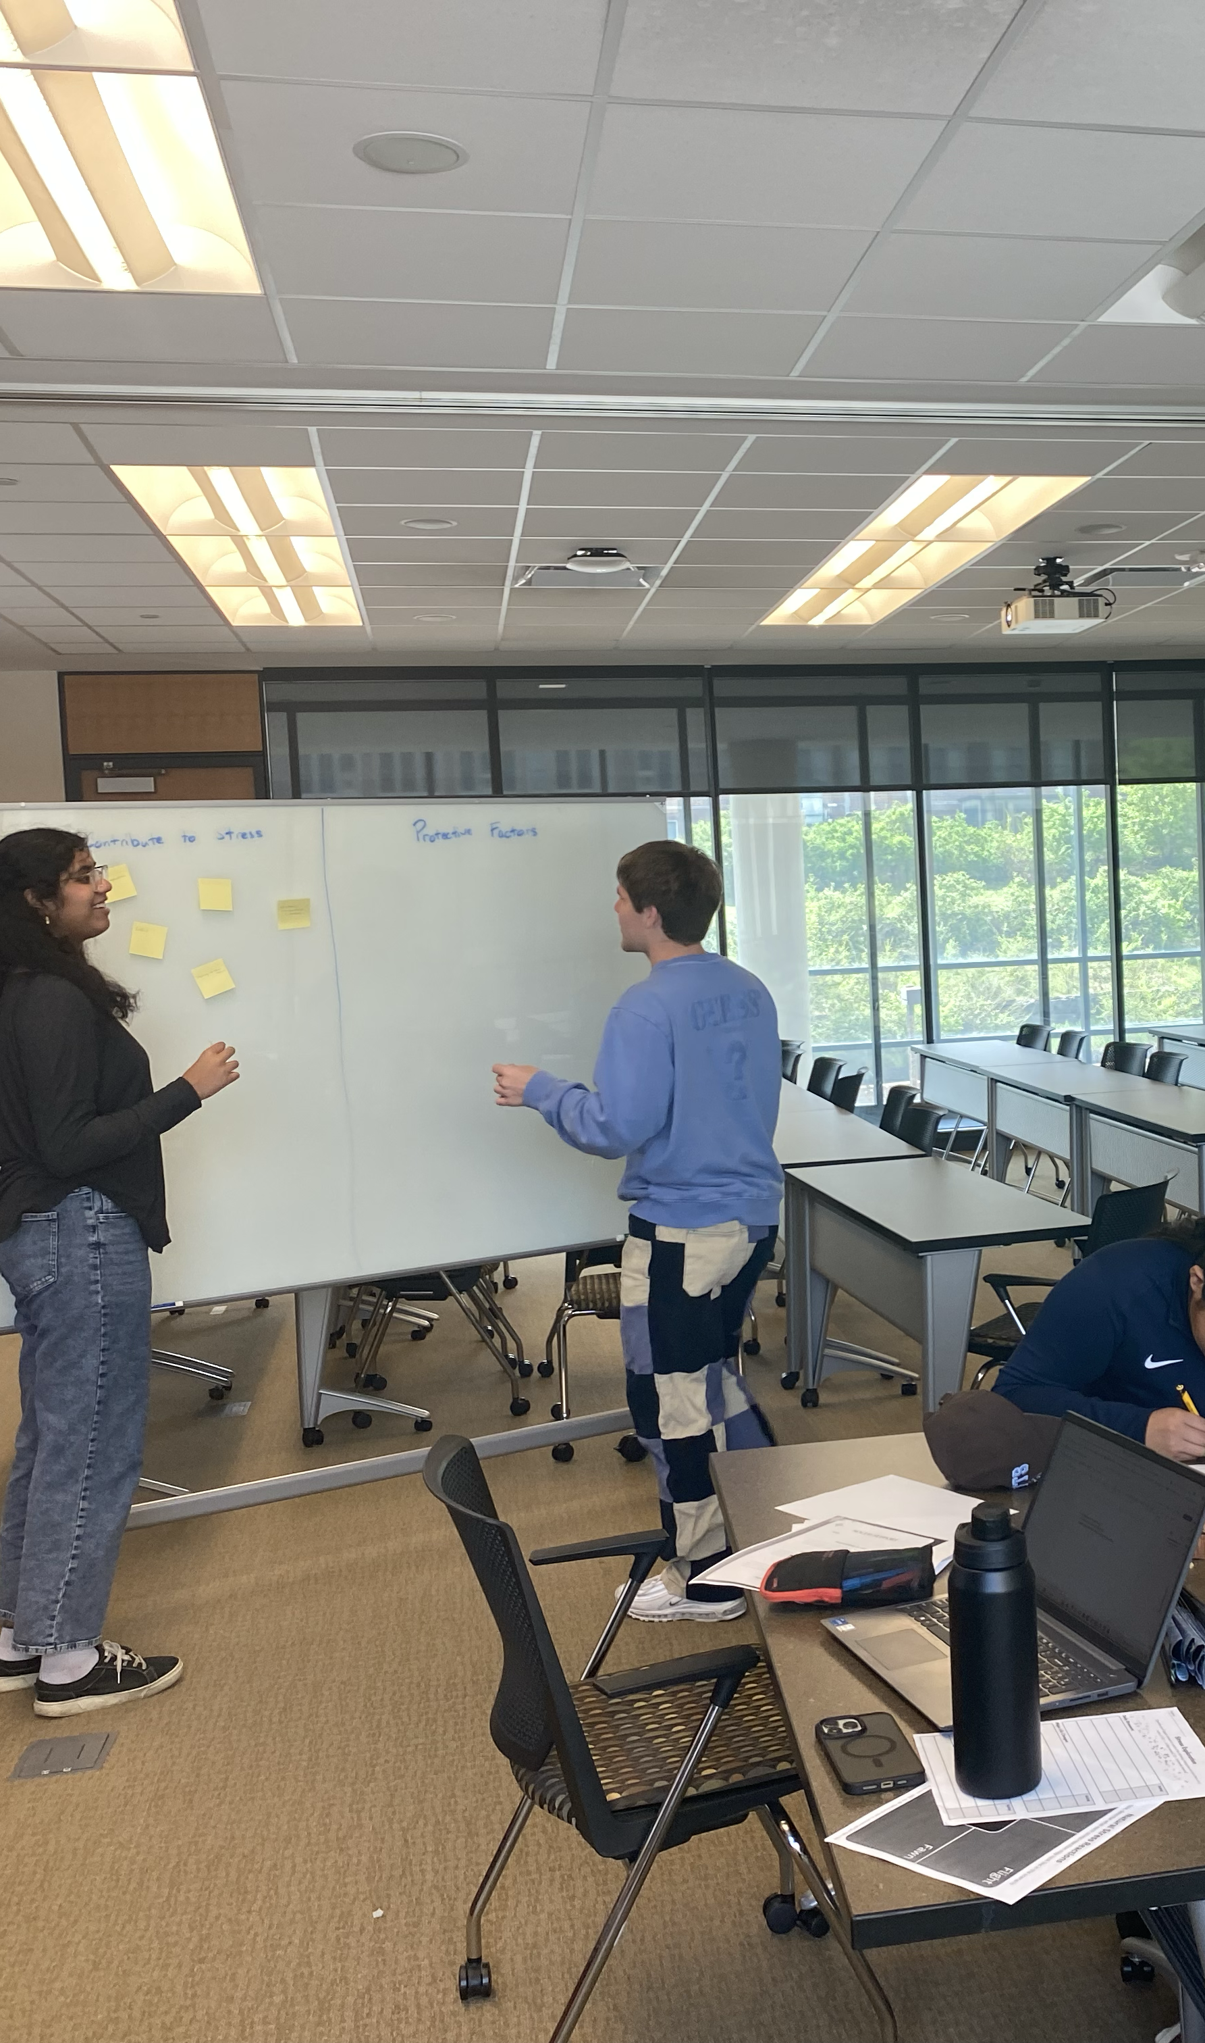
Key Processes of YPAR
Equitable power between youth and adults
Capacity Building
Collaboration from ideation to action
Building partnerships

Slide 10
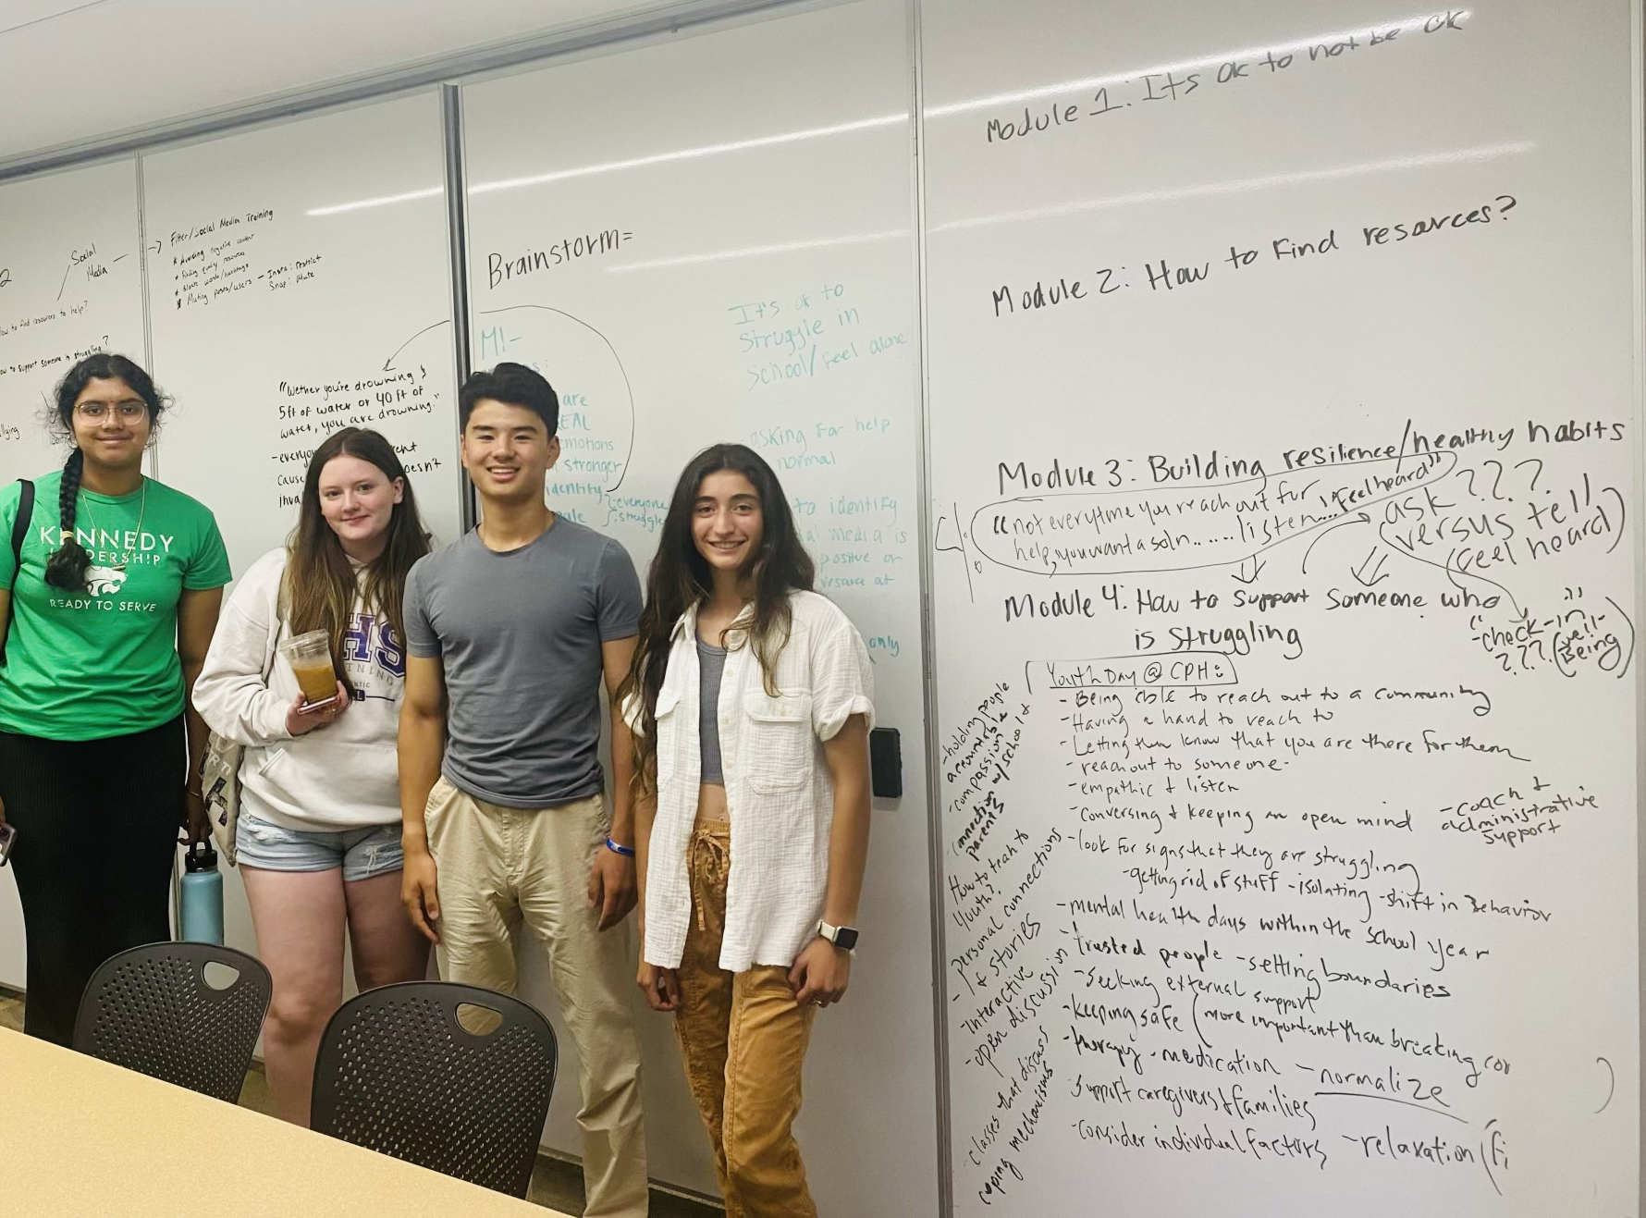
Process of Module Development
Saturday working meetings
  In-person, online, or hybrid
Ideation
Capacity Building
Encouraging Creativity and Branding

Slide 11
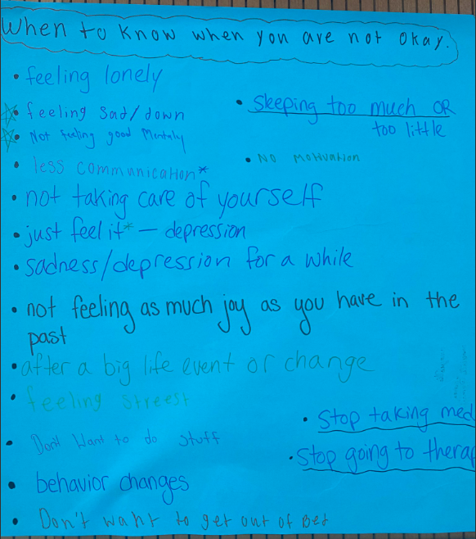
Ideation Phase
Example College of Public Health High School Visit Day June 13, 2023
  Prompted to create posters describing the mental health needs and concerns of Iowa's youth
  One poster described "when to know you are not okay"
  Brainstorming and ideation sessions with teen groups- our board and engaging in other opportunities such as this lays the groundwork
  Multiple meetings per module brainstorming content and process
  Emphasis on activity-driven and project-based learning with peers versus didactic or lecture-driven strategies

Slide 12
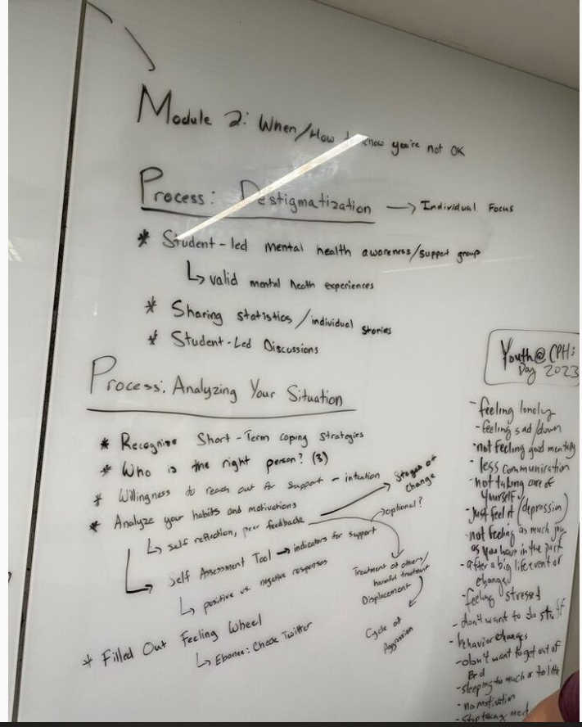
Use of white boards, posters, post-it notes helps with the ideation process
Photographing all artifacts so UI teams can cluster and categories and present a solidified structure (attending to theory and best practices) for youth critique and feedback
Meetings centered on one topic or subtopic at a time
  Some topics requiring multiple meetings and between meeting work

Slide 13
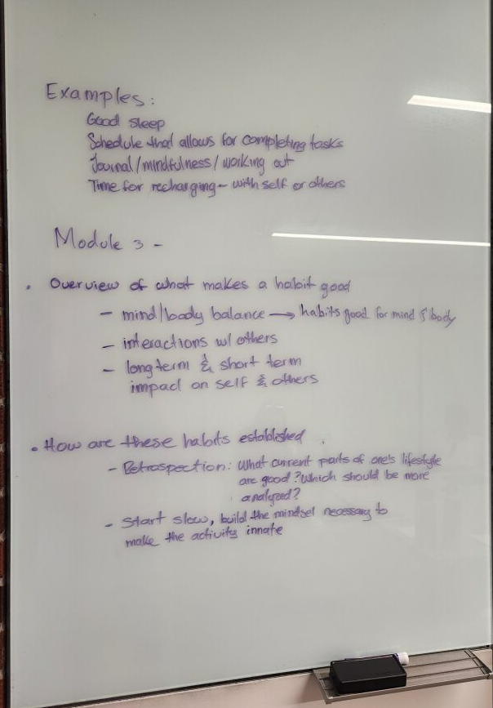
Strategic use of probing and clarifying:
Content and Process
Examples
  Good sleep
  Schedule that allows for completing tasks
  Journal/mindfulness/working out
  Time for recharging-with self or others
Overview of what makes a habit good
  Long term and short term
How are habits established?
  Start slow, build the mindset necessary to make the activity more inate...

Slide 14
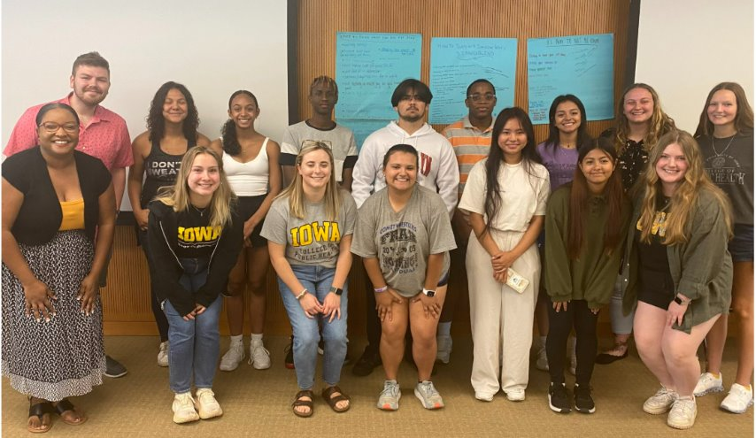
Module 1:
It's Okay to Not Be Okay

Slide 15
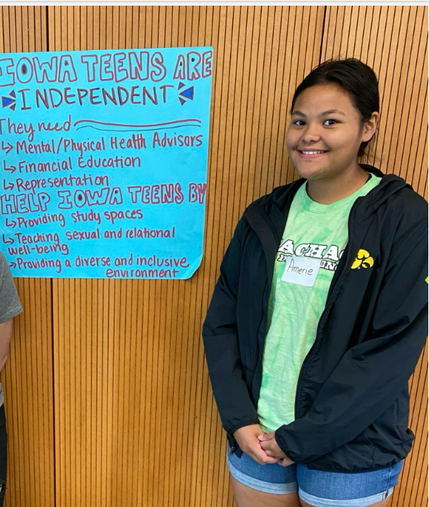
Module 1: Content Areas
What is Mental Health?
  Define and Discussion
Acknowledging Emotions
  Feeling Wheel Activity
Mental Health Stigma
  STIGMA word recognition activity
  Case Study
  Recommendations to Address Stigma
What does it mean to be okay?
  Reflections from Iowa Teens
  Symptoms to Recognize when one is not okay

Slide 16

Sample Activity
Write the 4 core emotions in the inner circle
  Happy, sad, mad, anxious
In the second circle, list 6 related emotions for each of the core emotions listed.
At home, please complete the outer circle, further expand your associated emotions from steps 1 and 2.

Slide 17
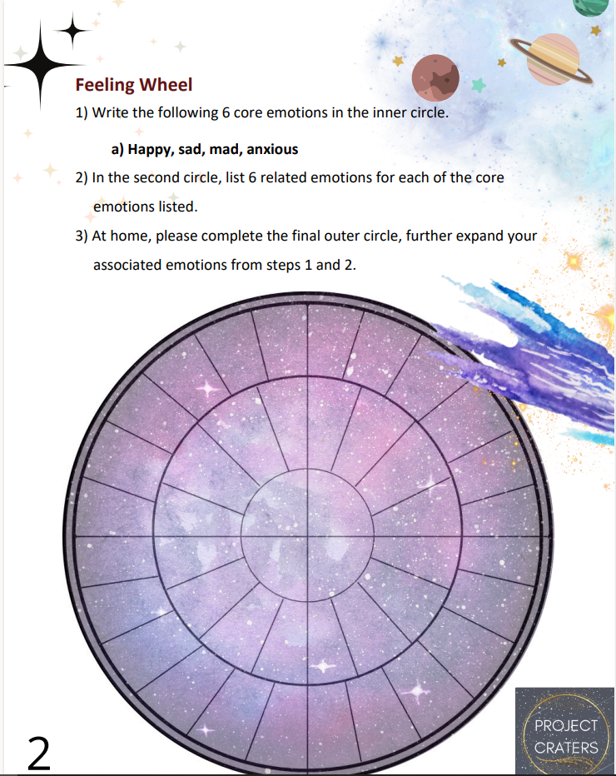

Slide 18
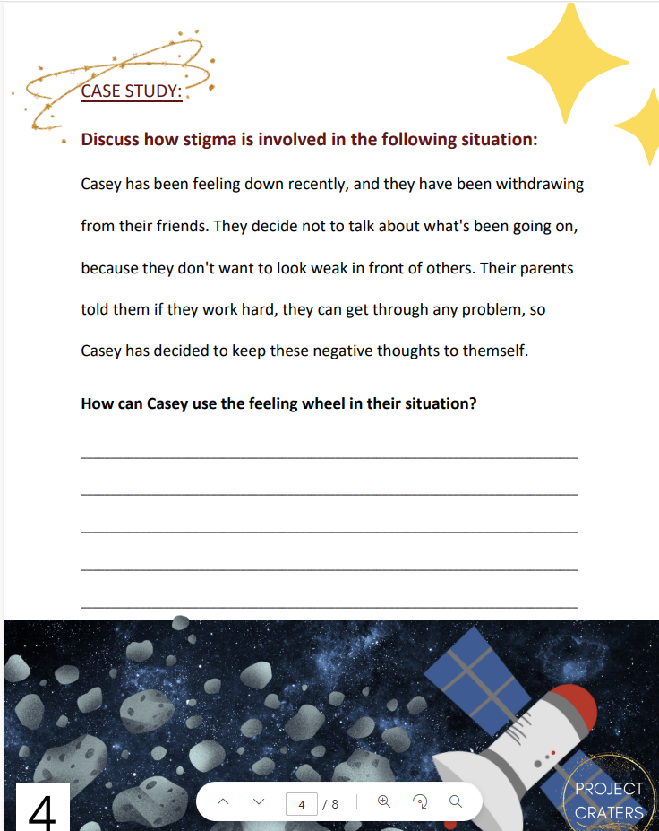
Sample Activity:
Case Study
CASE STUDY: Discuss how stigma is involved in the following situation:
Casey has been feeling down recently, and they have been withdrawing from their friends. They decide not to talk about what's been going on, because they don't want to look weak in front of others. Their parents told them if they work hard, they can get through any problem, so Casey has decided to keep these negative thoughts to themself.
How can Casey use the feeling wheel in their situation?

Slide 19
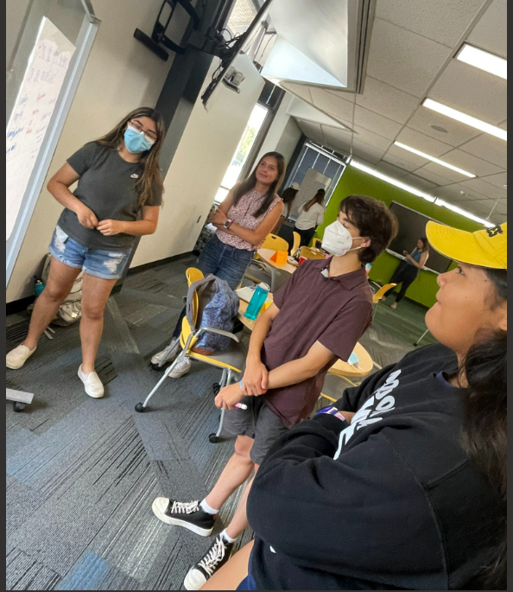
Module 2: Building Healthy Habits to Promote Hope and Resilience

Slide 20
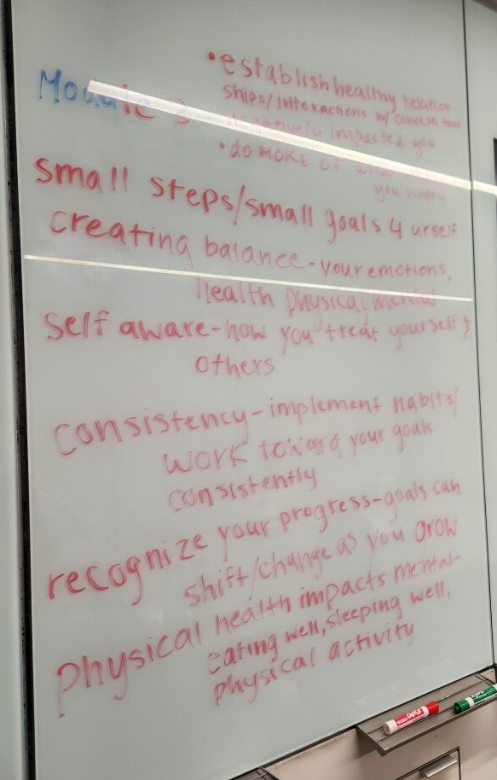
Module 2: Content Areas
What does health mean to you
  Definition and reflection
What are healthy habits?
  Brainstorming, defining
Self-reflection
  Discuss importance in context of building healthy habits
The power of hope
  Define, find connections between habits and hope, application activity
MARS Framework for building healthy habits
  Motivation, action, resilience, sustainability, case study activity

Slide 21
Iowa Teens' Definitions of Health
"Physical and mental" (codependent)
"Being able to fuel and support yourself to do the things you love"
"Stability and resilience"
"Knowing your limits and setting boundaries"
"Being able to do the things you love without limits"

Slide 22
Iowa Teens' Definition of Habits
"Actions repeated consistently"
"When you do something without really thinking about it"
Unhealthy habits: "things that [negatively] affect your health"
Healthy habits: "things that help your health"

Slide 23
Why is Hope Important?
Reflections from Iowa Teens
“so people don’t have more bad thoughts than good thoughts”
“it keeps people going”
“motivates people around you”
“it gives people confidence and good mental health”

Slide 24
Example Framework Developed by Teens:
MARS: A Framework for Building and Promoting Healthy Habits
Motivation
Action
Resilience
Sustainability
Notes:
Bella takes over:
Another aspect of module 2 is how these habits are built. Teens developed a framework for this MARS which stands for motivation, action, resilience, and sustainability. These are the stages that an individual goes through when developing healthy habits.

Slide 25
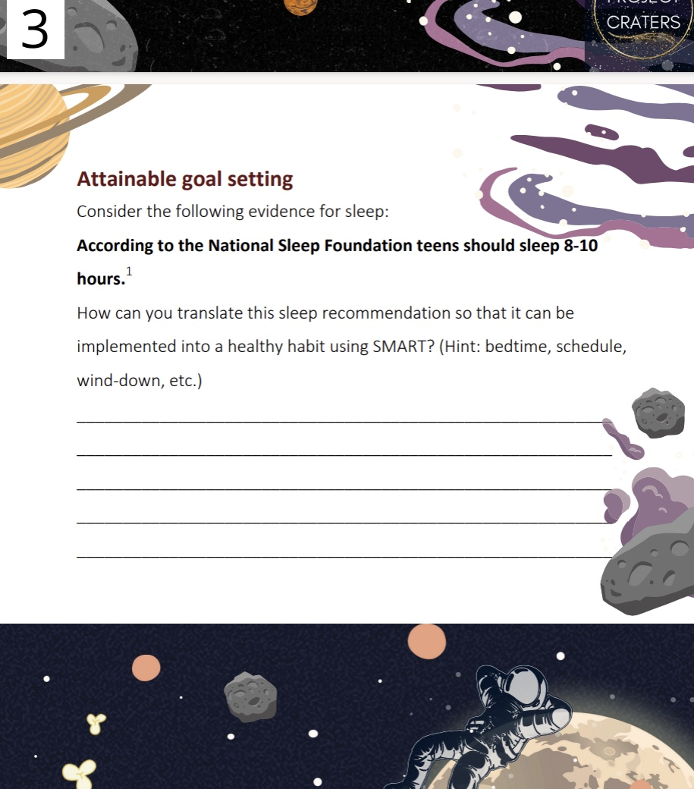
Sample Activity: Attainable Goal Setting
Directions: Consider the following evidence for sleep: According to the National Sleep Foundation teens should sleep 8-10 hours per night.
Activity: How can you translate this sleep recommendation so that it can be implemented into a healthy habit using SMART goals?
Notes:
SMART is part of the Action stage of MARS, and it stands for specific, measurable, achievable, relevant, and time-bound. In this activity we are encouraging students to take a general goal: better sleep, and convert it into a plan of action.

Slide 26
Case Study & Reflection
In groups of 3-4 people discuss the following case study:
"Alex is a junior in a suburban town. They have been staying up late on social media, which has led to them sleeping 4-5 hours on school nights. Alex often locks up in their room and doesn't interact with their siblings and family. Alex also stops for fast food multiple days per week. Alex talks with their friend on the bus ride to and from school daily, is on the swim team, and meets with their school counselor regularly to discuss academics.

Slide 27
Case Study Continued...
Categorize
In your groups, categorize Alex's habits into "healthy" or "unhealthy"
Talk about
Next, talk about ways Alex can use self-reflection to establish healthier habits. Explain why they should build those habits, and any difficulties they might encounter along the way.
Use
Use the provided graphic on your worksheet to visualize their habit building journey.
Discuss
Lastly, discuss how Alex can find motivation even in the presence of setbacks.
Notes:
What we hope to achieve with this activity is to help students understand that no one has a life made up of only healthy or unhealthy habits, but that there should be a balance. This idea was highlighted by teens in our team meetings.

Slide 28
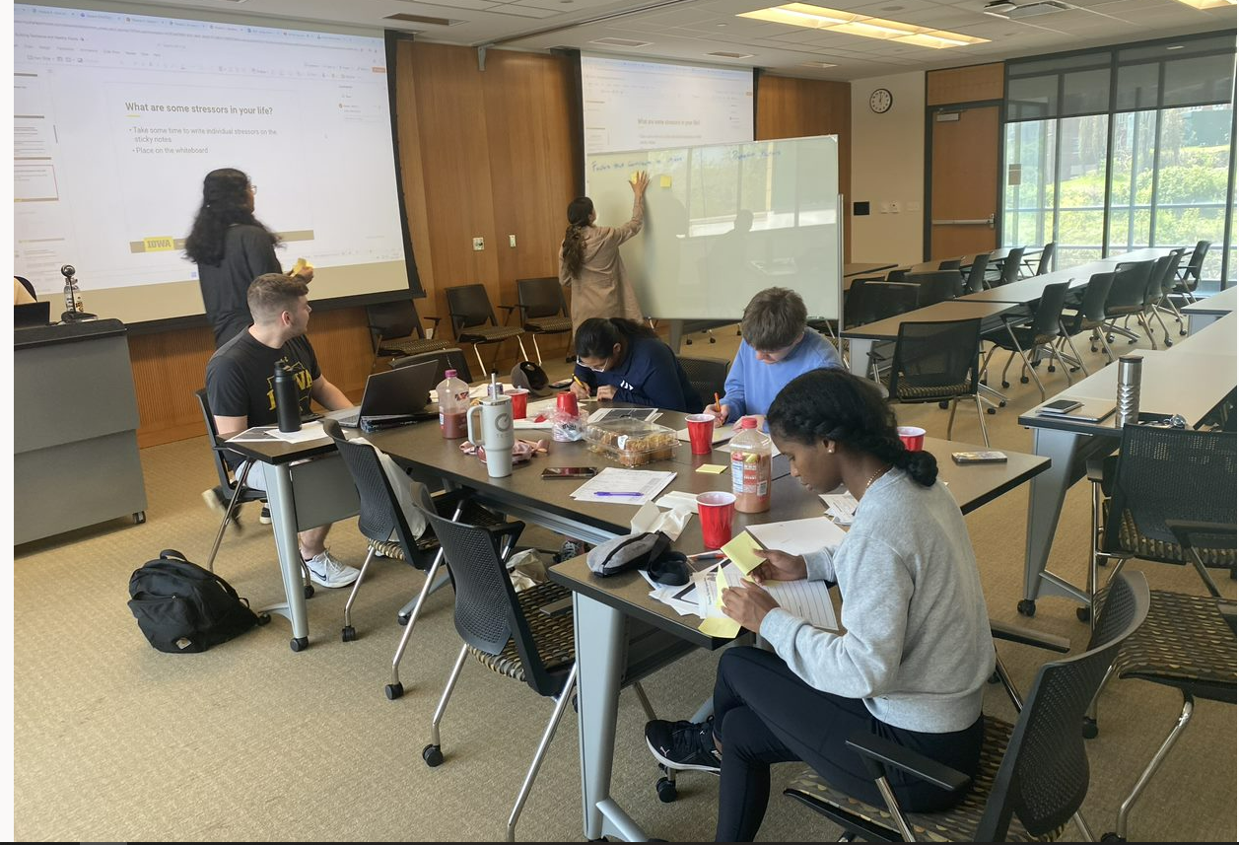
Module 3: Mental Health in Relationships

Slide 29
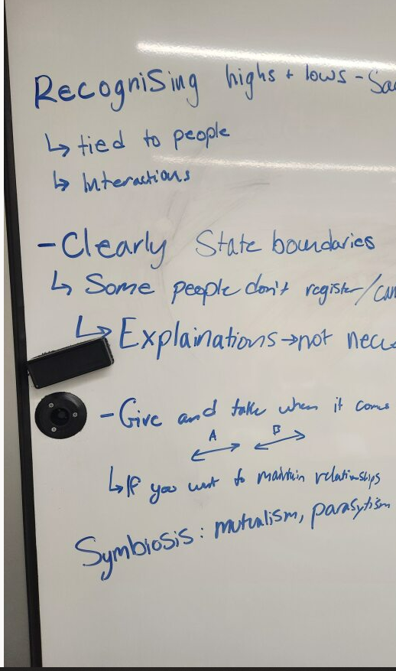
Module 3: Content Areas
What is a relationship
  Definition, types of relationships, activity-based application
What are different types of relationships
  How they differ
Boundaries
  Definition, how to set boundaries, ORBIT framework, brainstorming
Communication
  Definition, communicating needs in a relationship, communicating the end of a relationship, brainstorming

Slide 30
Setting Boundaries – O.R.B.I.T.
O: Open
Open communication
R: Reciprocal
Reciprocity in setting boundaries
B: Boundaries and
defining and communicating your limits and expectations within the relationship
I: Inclusion
involving the other person in the process of boundary setting
T: techniques
strategies and methods used to set and maintain boundaries
Notes:
By following the "ORBIT" principles, you can establish and maintain healthy boundaries in your relationship, leading to a more respectful, harmonious, and satisfying partnership. Open communication, reciprocity, clear boundaries, inclusion of both partners, and the use of effective techniques can help you navigate the complexities of human relationships with understanding and care.

Slide 31
Iowa Teens: Green Flags vs Red Flags in a Relationship
Green Flags
Respecting each other's boundaries
Good listening skills- making each other feel heard and understood
Feeling comfortable talking through issues
The control of the relationship isn't in one person's hands
Both individuals are on the same page regarding the seriousness of the relationship
Effort is equal from both sides
Showing that you care
Random acts of kindness
Self-awareness
Red Flags
One person "seeks" all the attention
Friend groups purposely excluding people
One-sided plans (one person makes all the effort)
Guilt-tripping
Being controlling
Not respecting physical boundaries
Disregarding someone's emotions
1 person makes all the decisions
Notes:
Another aspect of relationships is green flags v. red flags and I will let you read the examples that our youth board came up with. These terms are often highlighted in the media this age group consumes, making them relevant for teens. As you can infer, green flags are things that make a person seem like a good fit for you in a relationship while a red flag is a sign that this relationship is unhealthy.

Slide 32
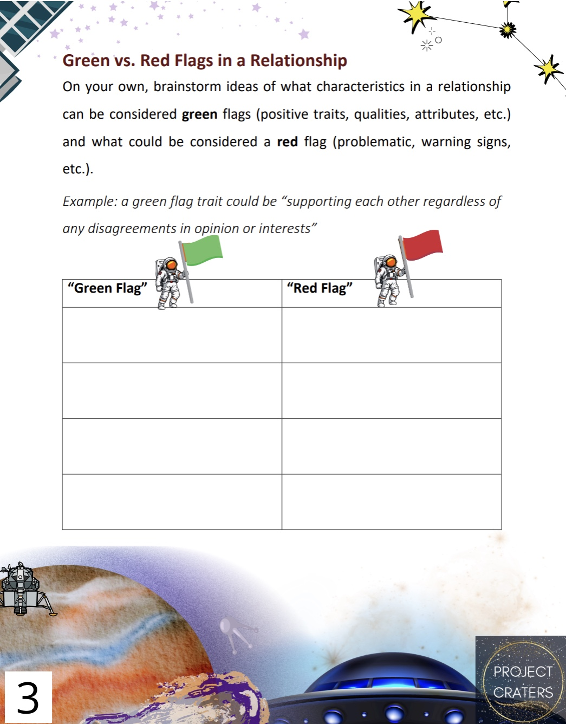
Sample Activity:
Directions: On your own, brainstorm ideas of what characteristics in a relationship can be considered green flags (positive traits, qualities, attributes, etc.) and what can be considered a red flag (problematic, warning signs, etc.)
Notes:
This activity connects directly with the idea of boundaries.

Slide 33
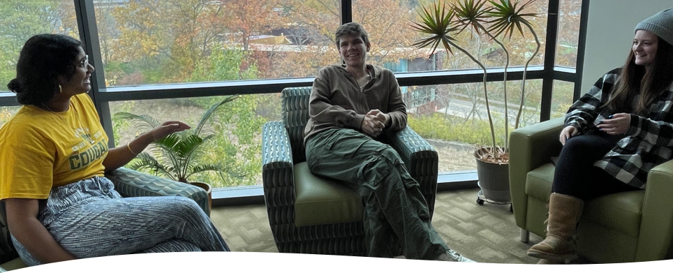
Module 4: How to Support Others

Slide 34
Module 4: Content Areas
Social support
  Definition, types, and the 3 Rs
Check-Ins
  Prevention and questions to consider
Recognizing Signs and Symptoms
  What are they?
Crisis Response
  Conversations and COME-T

Slide 35
Iowa Teens’ Recommendations
Listen
Listen first
Remind
Remind them that you’re available, being present
Know
Know when to support
Remember
Remember support looks different for different people
Intervene
Indirectly intervene;
Understand
Understand how people will interpret your support
Know what to do if they deny it
Provide
Provide resources
know the appropriate time to do so
don’t have to necessarily say “I'm trying to help you”; just reach out
Notes:
Disclaimer: make sure not to put your own mental health in jeopardy

Slide 36
COME-T Framework:
Check-in, Offer, Monitor, Encourage, Transfer
Check-in
Reaching out to your peer to show concern and assess the current state of the person experiencing the crisis
Offer
Making specific offers to address your peer's needs during a crisis
Monitor
Keep a close watch on your peer's well-being or situation over a period of time to assess changes or developments.
Encourage
Encourage your peer to seek professional help, stay strong in the face of adversity, or take other steps to address their crisis
Transfer
When necessary, link to trusted adults such as school counselor or student/family advocate.
Notes:
Check-in
To reach out to someone, often in a caring and supportive manner, to see how they are doing and to inquire about their well-being. It's a way to open communication and offer help.
Offer:
To provide something or extend assistance, support, or resources to someone in need.
Monitor
To assess changes or developments in the well being of someone
Encourage:
To encourage means to motivate or inspire someone to take certain actions, make positive choices, or maintain hope during a difficult situation.
Transfer
To refer the situation to a trusted resource. Because we must ensure that teens aren’t putting their own mental health in jeopardy this step is really important.

Slide 37
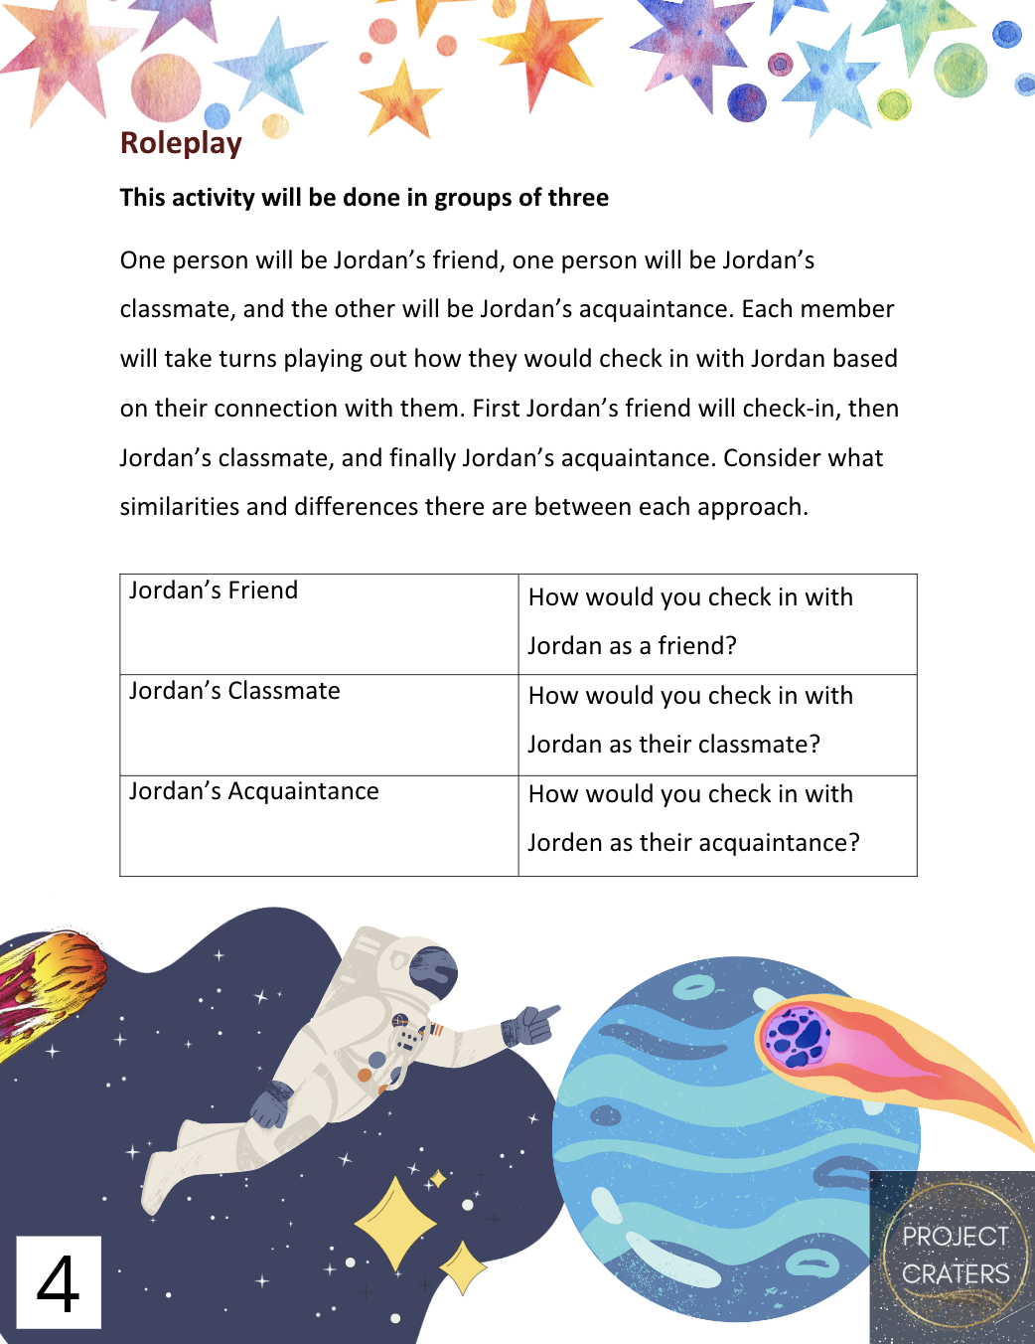
Sample Activity:
Think, Pair, Share: Check-in
Directions: Roleplay. This activity will be done in groups of 3. One person will be Jordan’s friend, one person will be classmate, and the other will be Jordan’s acquaintance.
Activity: Each member will take turns playing out how they would check in with Jordan based on their connection with them. First Jordan’s friend will check-in, then Jordan’s classmate, and finally Jordan’s acquaintance. Consider what similarities and differences there are between each approach.
Notes:
A roleplay activity where groups of three will discuss different approaches to helping Jordan based on their relationship with Jordan.

Slide 38
Piloting and Next Steps

Slide 39
Pre-Pilot of Module 1 with Iowa Teens
Spring 2024
  Advisory group invited friends to Saturday meeting, and they provided feedback on content
  Feedback: more activities, reorganization of modules, reduce from 5 to 4, make more applied
High school visit day at CPH, Fall 2025
  Delivered complete Module 1 for content and process feedback
  Qualitative reactions strong, particularly for the activity driven components and ability to work with peers versus just "lecture"
Notes:
In spring 2024 members of the youth board invited their friends and together they provided feedback on content, such as reducing content from 5 modules to 4.
We also did a pre-pilot of module 1 with high school students visiting the college of public health during the fall of 2024 (typo). We saw a positive response to the activity-based structure and a willingness to discuss in groups.

Slide 40
Next Steps
Pilot
  Upon receipt of IRB approval, larger pilot with Iowa City teens available in Summer 2025 to come to College of Public Health for a full day (with breakfast, lunch, and snacks provided; and breaks)
  Deliver all 4 modules
    Receive content and process feedback
    Pre-test on mental health literacy and post-test to determine impact of intervention with validated instruments.
Funding:
  Spring 2024: submitted grant to Substance Abuse and Mental Health Services Administration, good score, but not funded
  Spring 2025: resubmitted grant based on reviewer feedback; find out August 2025
  Ability to deliver CRATERS across Johnson and Linn County
  Expand teen working group
Notes:
Our next steps include piloting and funding. Once we receive IRB approval we will be recruiting teens to participate in all four modules and measure the impact of our curriculum by having a mental health literacy test pre and post participation. Funding-wise we applied to multiple grants. This money would be used to expand teen working group (we aren’t currently able to pay more people for their time and efforts).

Slide 41
Mental Health Outreach and Engagement

Slide 42
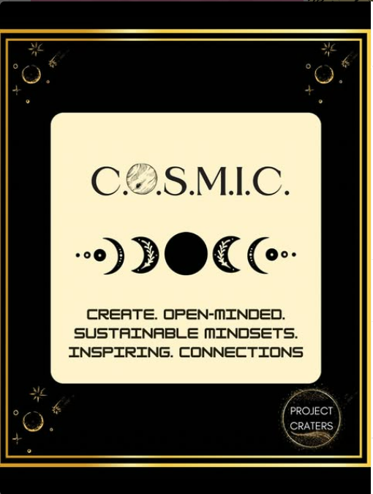
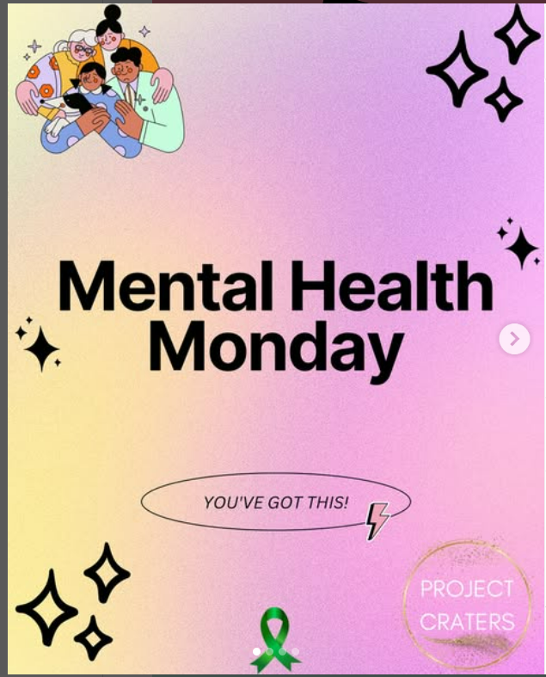
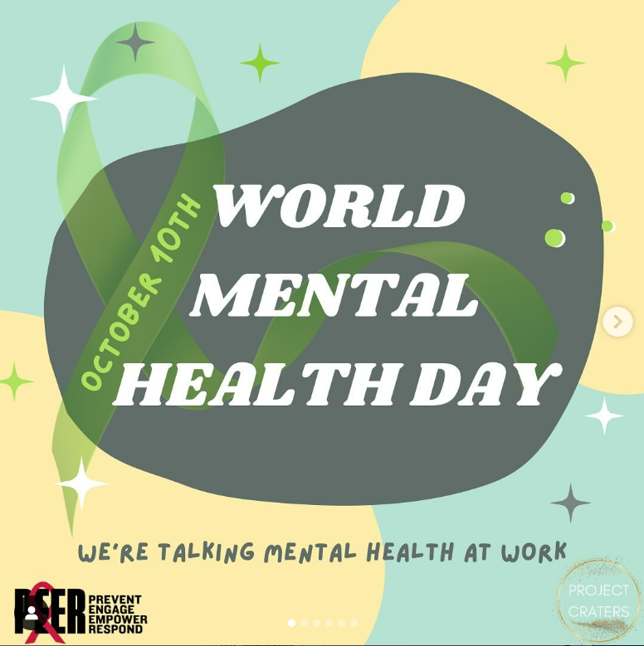
Social Media: Instagram @projectcraters
Notes:
Part of our engagement efforts has been through social media. The post to the left was developed by our youth board during one of our Saturday meetings. The second is part of a series mental health Monday in which we post every Monday about a mental health topic such as the effects of stress. And finally, we make posts for occurrences that are relevant to mental health such as WMHD and national depression screening day both in October

Slide 43
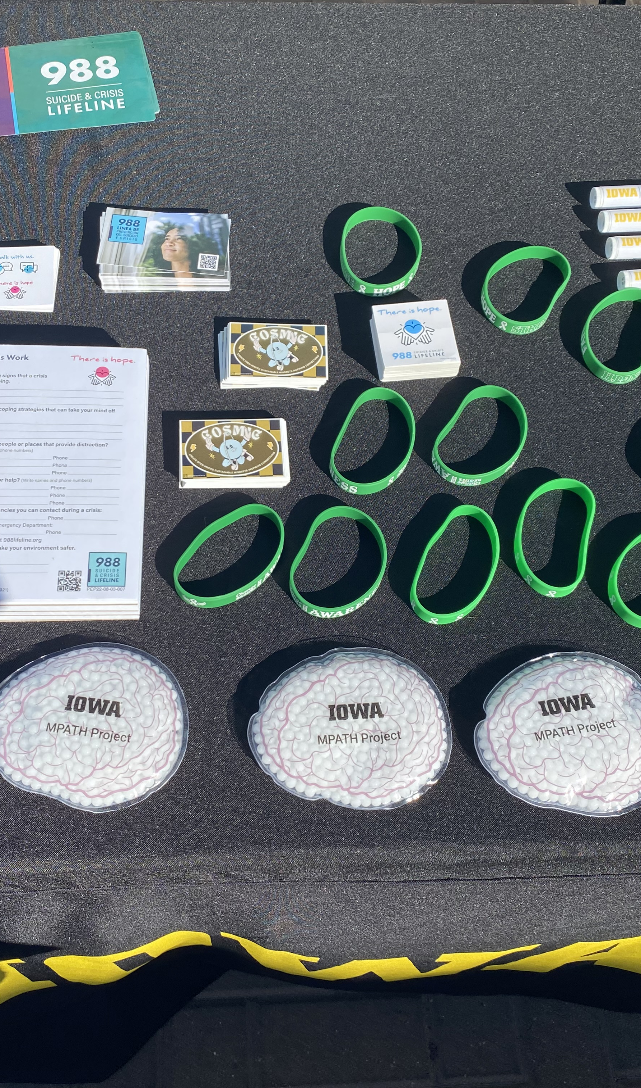
Community Events
Community Corridor Action Network Volunteer and Civic Engagement Festival (CCAN-2024)
Notes:
We have also attended community events such as the CCAN festival last year

Slide 44
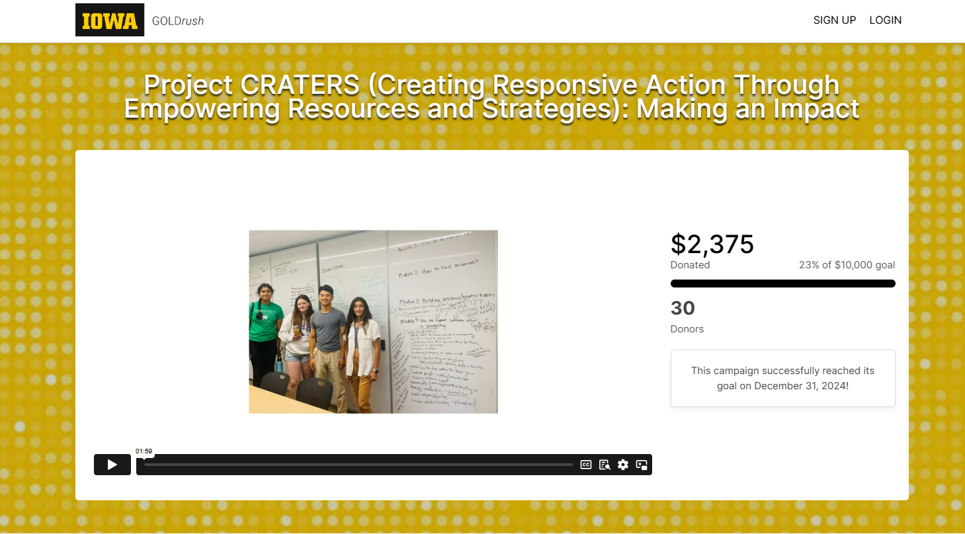
Fundraising
Notes:
Another fundraising effort was through GOLDrush and we were able to raise $2375

Slide 45
Key References
Ozer, E. J., & Douglas, L. (2015). Assessing the key processes of youth-led participatory research: Psychometric analysis and application of an observational rating scale. Youth & Society, 47, 29-50.
Ozer, E. J. (2016). Youth-led participatory action research: Developmental and equity perspectives. Advances in child development and behavior, 50, 189-207.
Rhodes, S. D., Tanner, A. E., Mann-Jackson, L., Alonzo, J., Simán, F. M., Song, E. Y., ... & Aronson, R. E. (2018). Promoting community and population health in public health and medicine: A stepwise guide to initiating and conducting community-engaged research. Journal of Health Disparities Research and Practice, 11(3), 16.

Slide 46
Questions?
Contact:
Ebonee Johnson, Ph.D. ebonee-johnson@uiowa.edu
https://www.public-health.uiowa.edu/people/ebonee-johnson/
Notes:
If you have any questions please contact Dr. Ebonee Johnson who was unable to join us today.

Slide 47
Thank you
uiowa.edu

